Slide 1


X’MAS &
NEW YEAR
MANALI TRIPS
4D/3N
MANALI-SOLANG-KASOL
DISCOUNTED PRICES!
Contact-7210780678

Slide 2
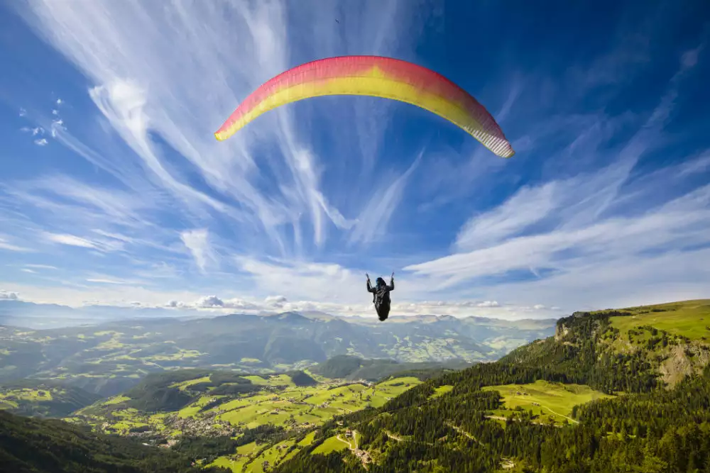
Pre-Festive Batches
15 Dec to 20 Dec
16 Dec to 21 Dec
Day0-DEPART
Day1-MANALI
Day2-SOLANG
Day3-KASOL
Day4-RETURN
Day5-DROP
Starting from 6500 Only/-

Slide 3
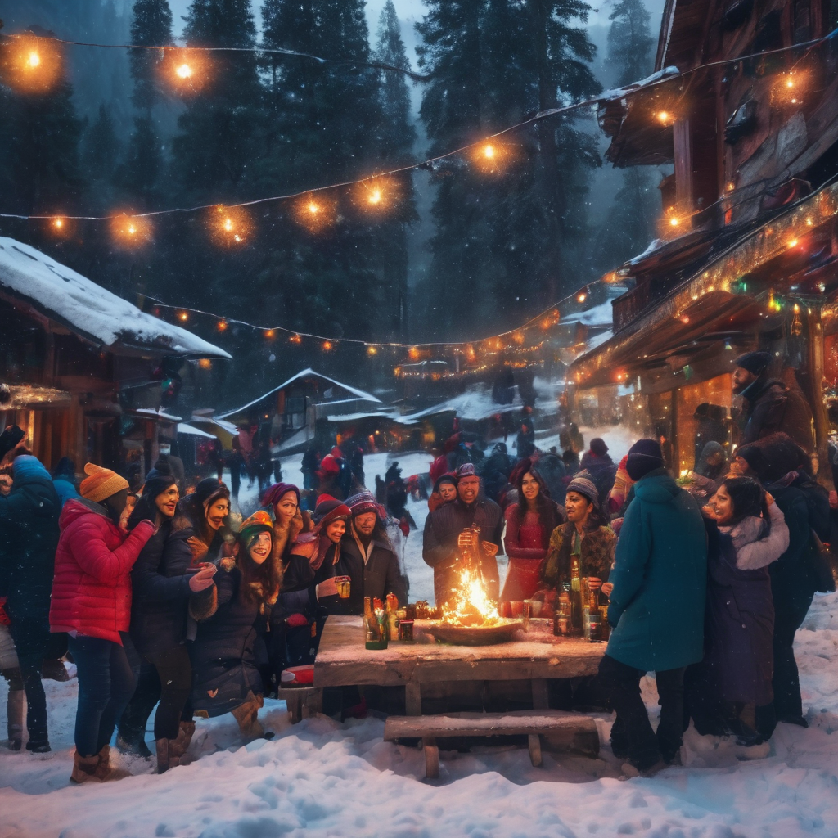
BATCH-1&2
22 Dec to 27 Dec-X’MAS
28 Dec to 02 Jan-NEW YEAR
Day0-DEPART
Day1-MANALI
Day2-SOLANG
Day3-KASOL
Day4-RETURN
Day5-DROP
PARTY IN KASOL!

Slide 4
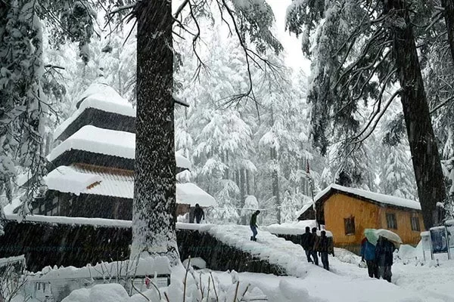
BATCH-3&4
23 Dec to 28 Dec-X’MAS
29 Dec to 03 Jan-NEW YEAR
Day0-DEPART
Day1-MANALI
Day2-SOLANG
Day3-KASOL
Day4-RETURN
Day5-DROP
PARTY IN MANALI!

Slide 5
PRICES-(MIN 25% Discount)
Quad Sharing-10000/- 7500/-
Triple Sharing-11000/-8000/-
Double Sharing-12000/-8500/-
Hotels-
Apple Valley View-Manali
Valley View/Nirmal Camps-Kasol
(as per availability in Kasol)
Inclusions-
3 Breakfast/3 Dinners
All Permits
Tour Coordinator
Bonfire & Music
Contact-7210780678

